Slide 1
MENTAL WELLNESS PREDICTION
M RIYAS MOHAMMED

Slide 2


GOAL
STATEMENT
The project focuses on using machine learning (ML) and Long short-Term Memory(LSTM) to identify and predict mental wellness issues in students. By examining factors like academic depression, mental thought patterns, and dietary habits. This proactive approach allows healthcare professionals to offer personalized support, ultimately improving students' overall well-being.
CONFIDENTIAL: The information in this document belongs to Boston Institute of Analytics LLC. Any unauthorized sharing of this material is prohibited and subject to legal action under breach of IP and confidentiality clauses.

Slide 3

WHY PROJECT IS IMPORTANT
Rising Importance of Mental Health
Mental health issues are increasingly prevalent, with millions affected worldwide.
Improved Quality of Life
Early prediction supports individuals in managing stress, emotions, and mental well-being effectively, improving their overall life satisfaction.
Workplace Productivity and Employee Well-being
Predictive tools help employers monitor and improve employee wellness, reducing absenteeism and enhancing workplace productivity.
Enhances Academic Performance
Predicting mental health issues helps identify signs of stress caused by academic pressure, deadlines, and exams.
Early prediction helps maintain a healthy balance between academic and personal life.

Slide 4

PROJECT OVERVIEW
Datasets
Depression Sentiment Dataset: 53,043 entries with text based statements and sentiment labels.
Student Depression Dataset: 27,901 entries, 18 columns including dietary habits, depression levels, academic pressure, sleep duration, and mental health-related factors.
Targets
The Depression Sentiment Dataset: targets status with categories like Normal – Depression – Suicidal – Anxiety – Bipolar – Stress and Personality disorder.
The Student Depression Dataset: focuses on Health Condition Unhealthy- Moderate – Healthy and a binary Depression column: Yes and No.
Model
Various machine learning techniques were applied to classify student depression data and Dietary Habit ,while Long Short-Term Memory (LSTM) was utilized for depression sentiment analysis.
Deployment
For deployment, I utilized Streamlit to predict mental health outcomes using the model. The user data submitted to the model is stored in both MongoDB and Excel for further analysis and record-keeping. Additionally, Power BI is used to visualize user performance, providing insights through interactive dashboards and reports.

Slide 5
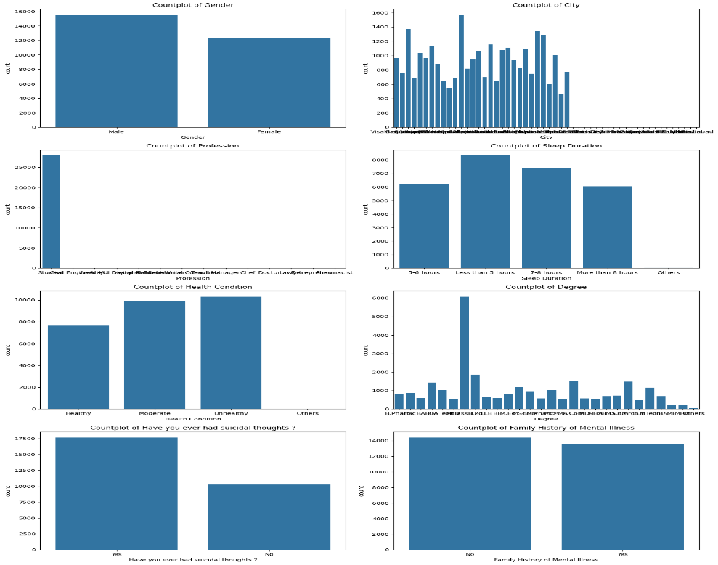
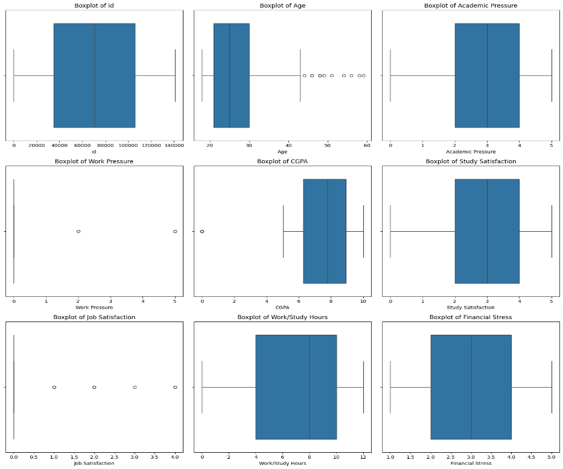
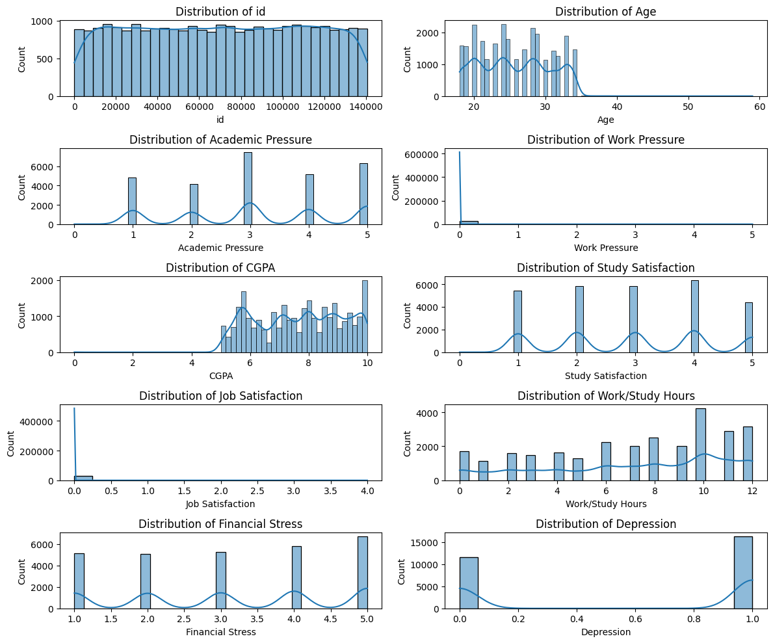
EXPLORATION DATA
Count Plot
Box Plot
Hist with KDE Plot
A nearly equal representation of males and females in the dataset
Students make up the largest group in the dataset.
Other professions like engineers, doctors, and teachers also have notable representation.
Nearly equal distribution between individuals reporting moderate and unhealthy conditions, with fewer individuals categorized as healthy.
Age and Work Pressure: Show significant outliers.
From these analysis job Satisfaction and Work pressure can be dropped.
Outlier Handling: Robust Scaler for small outliers.
Right-skewed distribution, with most individuals aged between 20-30.
Right-skewed distribution, with most individuals studying/working around 4-6 hours
Highly skewed to the left, with most individuals scoring close to 0.
Skewness Handling: Applied Log Transformer to normalize data.

Slide 6
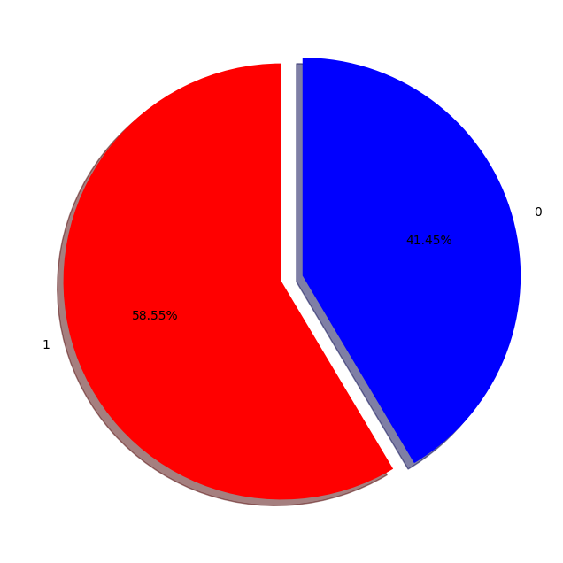
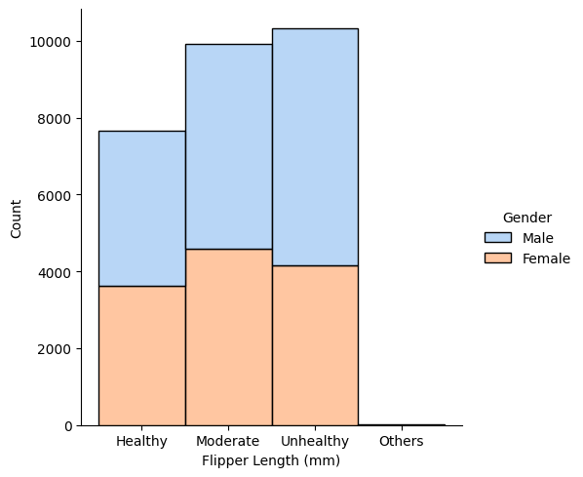
TARGET EXPLORATION
Depressed
Represents 58.55% of the data.
Categories: Health statuses ("Healthy," "Moderate," "Unhealthy," "Others") based on flipper length.
Counts: "Unhealthy" has the highest count, "Others" the least.
Gender: Males (blue) outnumber females (peach) in all groups.
Insight: "Unhealthy" dominates; males are more prevalent overall.
Not Depressed
Represents 41.45% of the data
Dietary Habit
Both data needs to be rebalanced using SMOTE (Synthetic Minority Oversampling Technique) to address class imbalance and enhance analysis accuracy

Slide 7
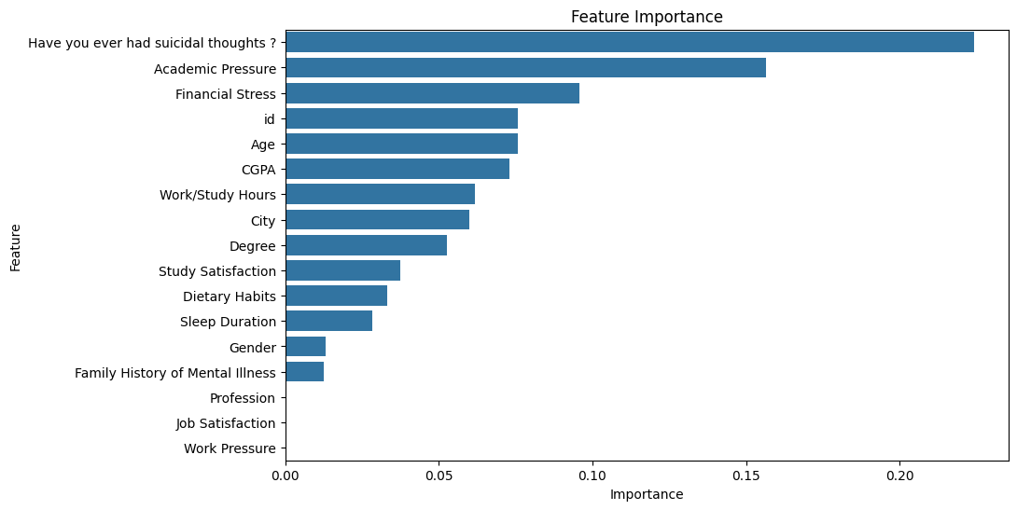
FEATURE SELECTION
The Student Depression Dataset consists of 27,901 entries with 18 columns.
The bar charts visualizes the feature importance. It ranks features based on their contribution to the model's predictive accuracy. Key observations include
Depression Feature Importance

Slide 8
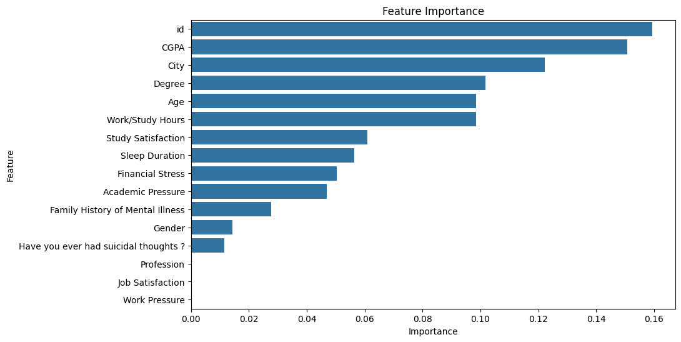
FEATURE SELECTION
Dietary Habits Feature Importance
Features Selected = (Gender, Age, Have you ever had suicidal thoughts ?,Financial Stress, CGPA, Academic Pressure , Degree, Work/Study Hours, Sleep Duration)
Target = (Depression , Dietary Habit)
City: While city might seem relevant, it could be a noisy feature if the data isn't granular enough. If the target variable doesn't vary significantly across cities, or if there's a lack of data for certain cities, it might not be a useful predictor
ID: If the ID feature is somehow related to the target variable in a way that wouldn't be available in real-world scenarios, using it could lead to data leakage. This means your model would perform well on the training data but poorly on new, unseen data.

Slide 9
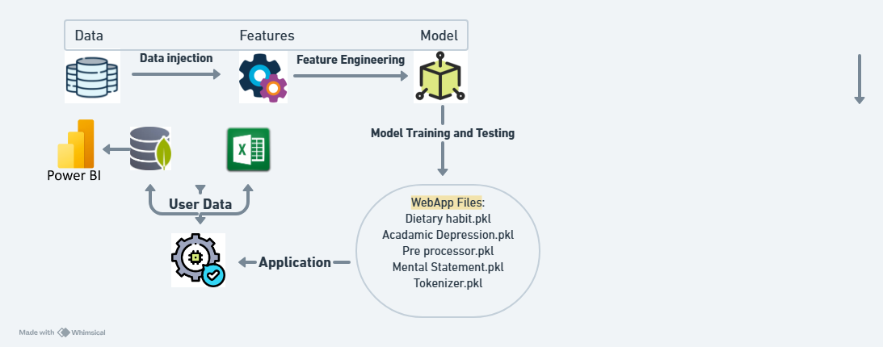
PROJECT FRAMEWORK

Slide 10
MODEL SELECTION
K-Neighbors Classifier:
Non-parametric method that captures complex patterns in data.
Does not assume a specific distribution, making it flexible.
Effective for smaller datasets and handles multi-class classification well.
Random Forest Classifier:
Ensemble method that combines multiple decision trees to enhance accuracy.
Controls overfitting, providing a more robust model.
Offers insights into feature importance, aiding in understanding factors influencing depression.
Gradient Boosting Classifier:
Builds models sequentially, correcting errors from previous models.
Often yields high predictive performance.
Robust to overfitting when properly tuned.
Decision Tree Classifier:
Easy to interpret and visualize, useful for understanding decision-making processes.
Captures non-linear relationships and interactions between features effectively.
LSTM (Long Short-Term Memory) for Sentiment Analysis:
Sequential Handling – Ideal for text-based sentiment analysis
Long-Term Memory – Captures dependencies in text.
Context Retention – Focuses on key words for accuracy.
Pattern Recognition – Detects subtle depressive sentiments.

Slide 11
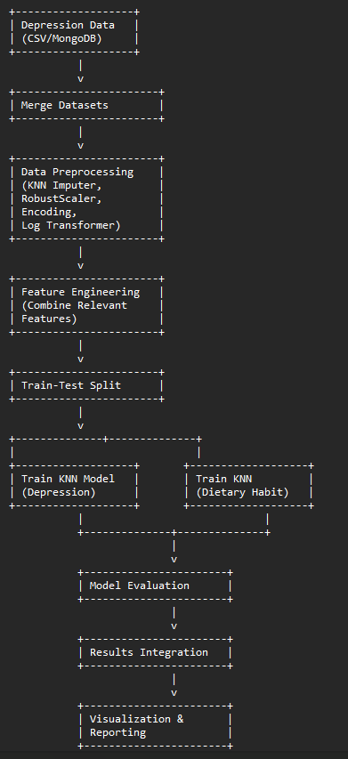
WORK ARCHITECTURE OF CLASSIFICATION MODEL

Slide 12
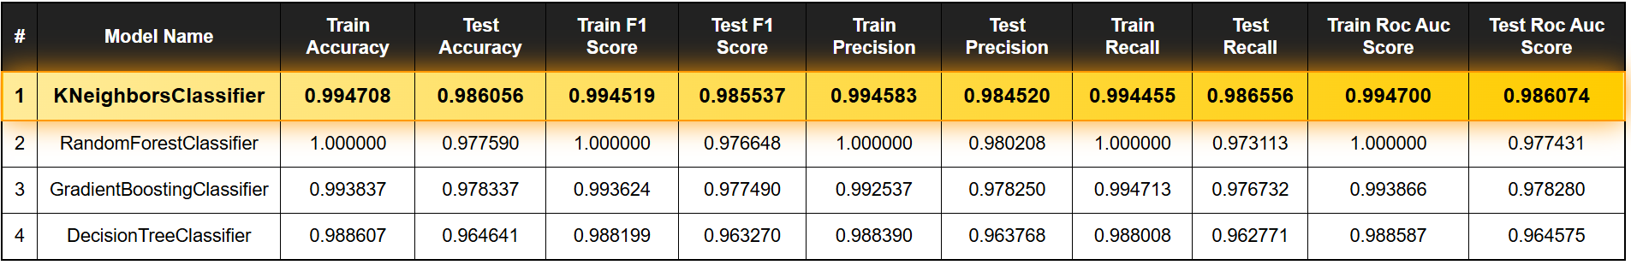
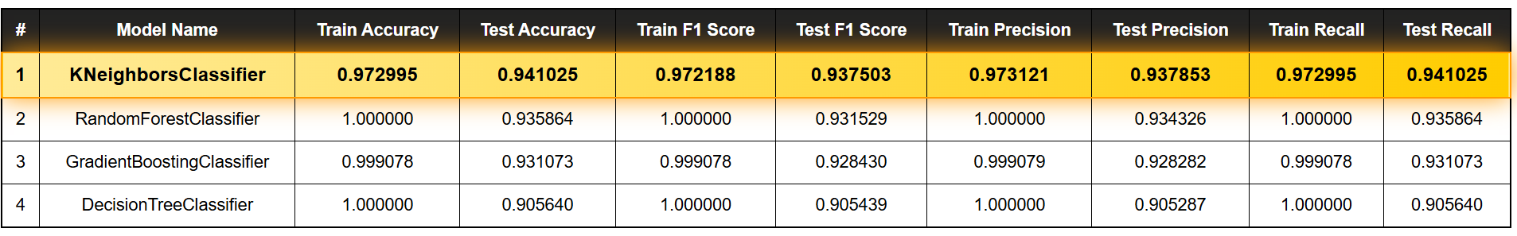
MODEL CLASSIFICATION REPORT
Depression Model Report
Dietary Habit Model Report

Slide 13
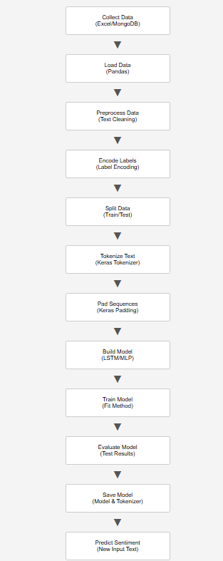
WORK ARCHITECTURE OF SENTIMENT MODEL
Epochs in Training : 15
Train Accuracy : 0.81
Test Accuracy : 0.72

Slide 14
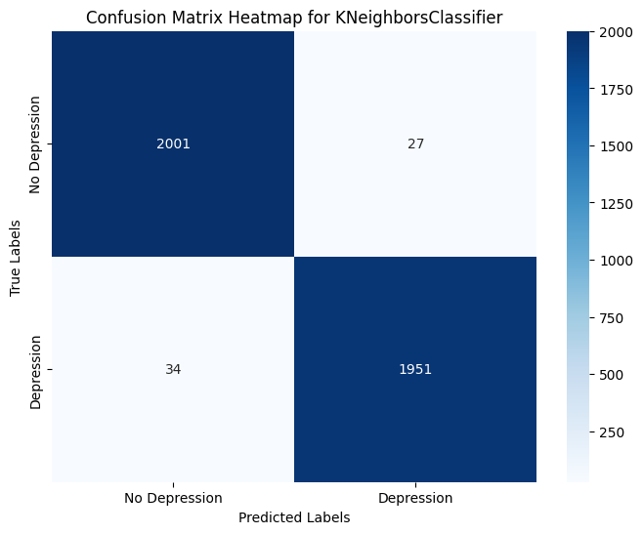
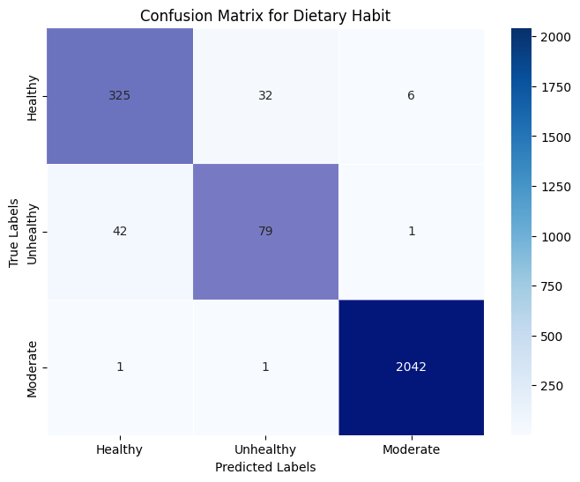
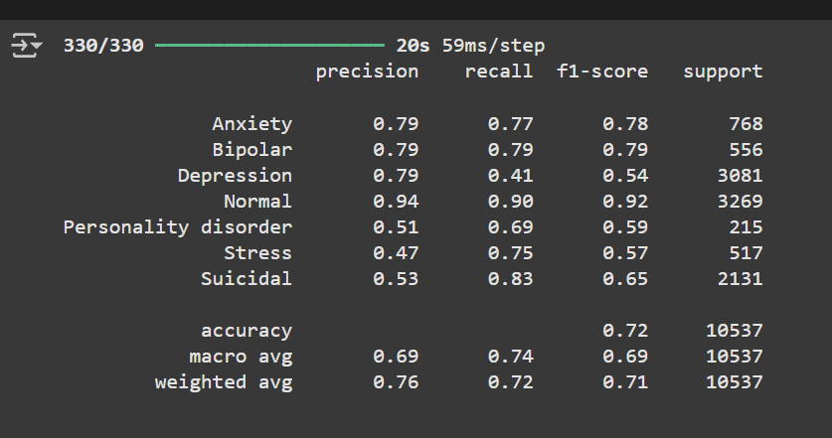
RESULTS
Heat map Correctly predicted on Depression
Heat map Correctly predicted on Dietary Habit
Sentiment Classification Report
High Accuracy:
The majority of predictions are correct:
2001 for "No Depression."
1951 for "Depression."
This indicates the model is performing well overall.
High Accuracy:
The model correctly predicted 325 instances as Healthy (True Positives).
The model correctly predicted 79 instances as Unhealthy.
The model correctly predicted 2042 instances as Moderate.
Classification Report Summary:
Anxiety: Balanced performance (Precision: 0.79, Recall: 0.77, F1: 0.78).
Normal: Strong accuracy (Precision: 0.94, Recall: 0.90).
Stress: High recall (0.75) ensures correct identification.
Overall Accuracy: 72%, indicating solid performance.

Slide 15
MODEL DEPLOYMENT
Deployment: The model has been successfully deployed using the Streamlit framework, providing a user-friendly interface for interaction.
Sentiment Analysis: The model is capable of predicting real-life sentiments with high accuracy, making it applicable to various practical scenarios.
Future Development: There is potential for the model to evolve into a fully functional application. This would enhance its usability and accessibility for a broader audience.
Data Management: When users interact with the model, their data will be securely stored and managed in a MongoDB database, ensuring scalability, reliability, and data integrity
Real-Life Applications – Helps students manage academic stress, track emotional well-being, and access early mental health support.
Performance Visualization – Power BI analyzes and visualizes student mental wellness trends based on data collected from Streamlit, helping educators and counselors provide targeted support.

Slide 16
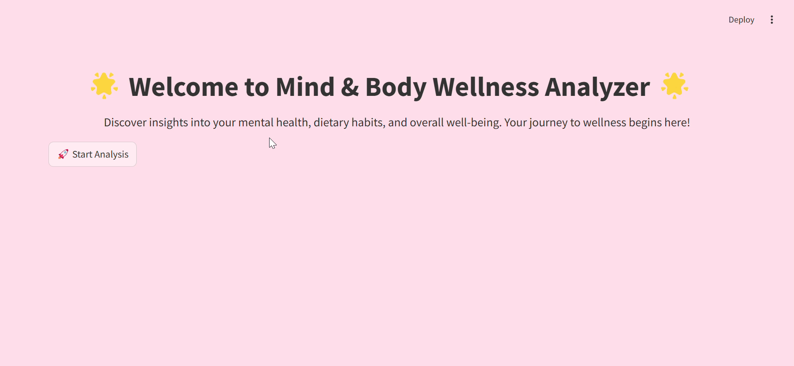
STREAMLIT DEPLOYMENT

Slide 17

Thank You!
CONFIDENTIAL: The information in this document belongs to Boston Institute of Analytics LLC. Any unauthorized sharing of this
material is prohibited and subject to legal action under breach of IP and confidentiality clauses.

